Slide 1
FIT3179 Studio Week8
Date: 13/9/2023 | Presenter: Songhai (Frank) Fan

Slide 2
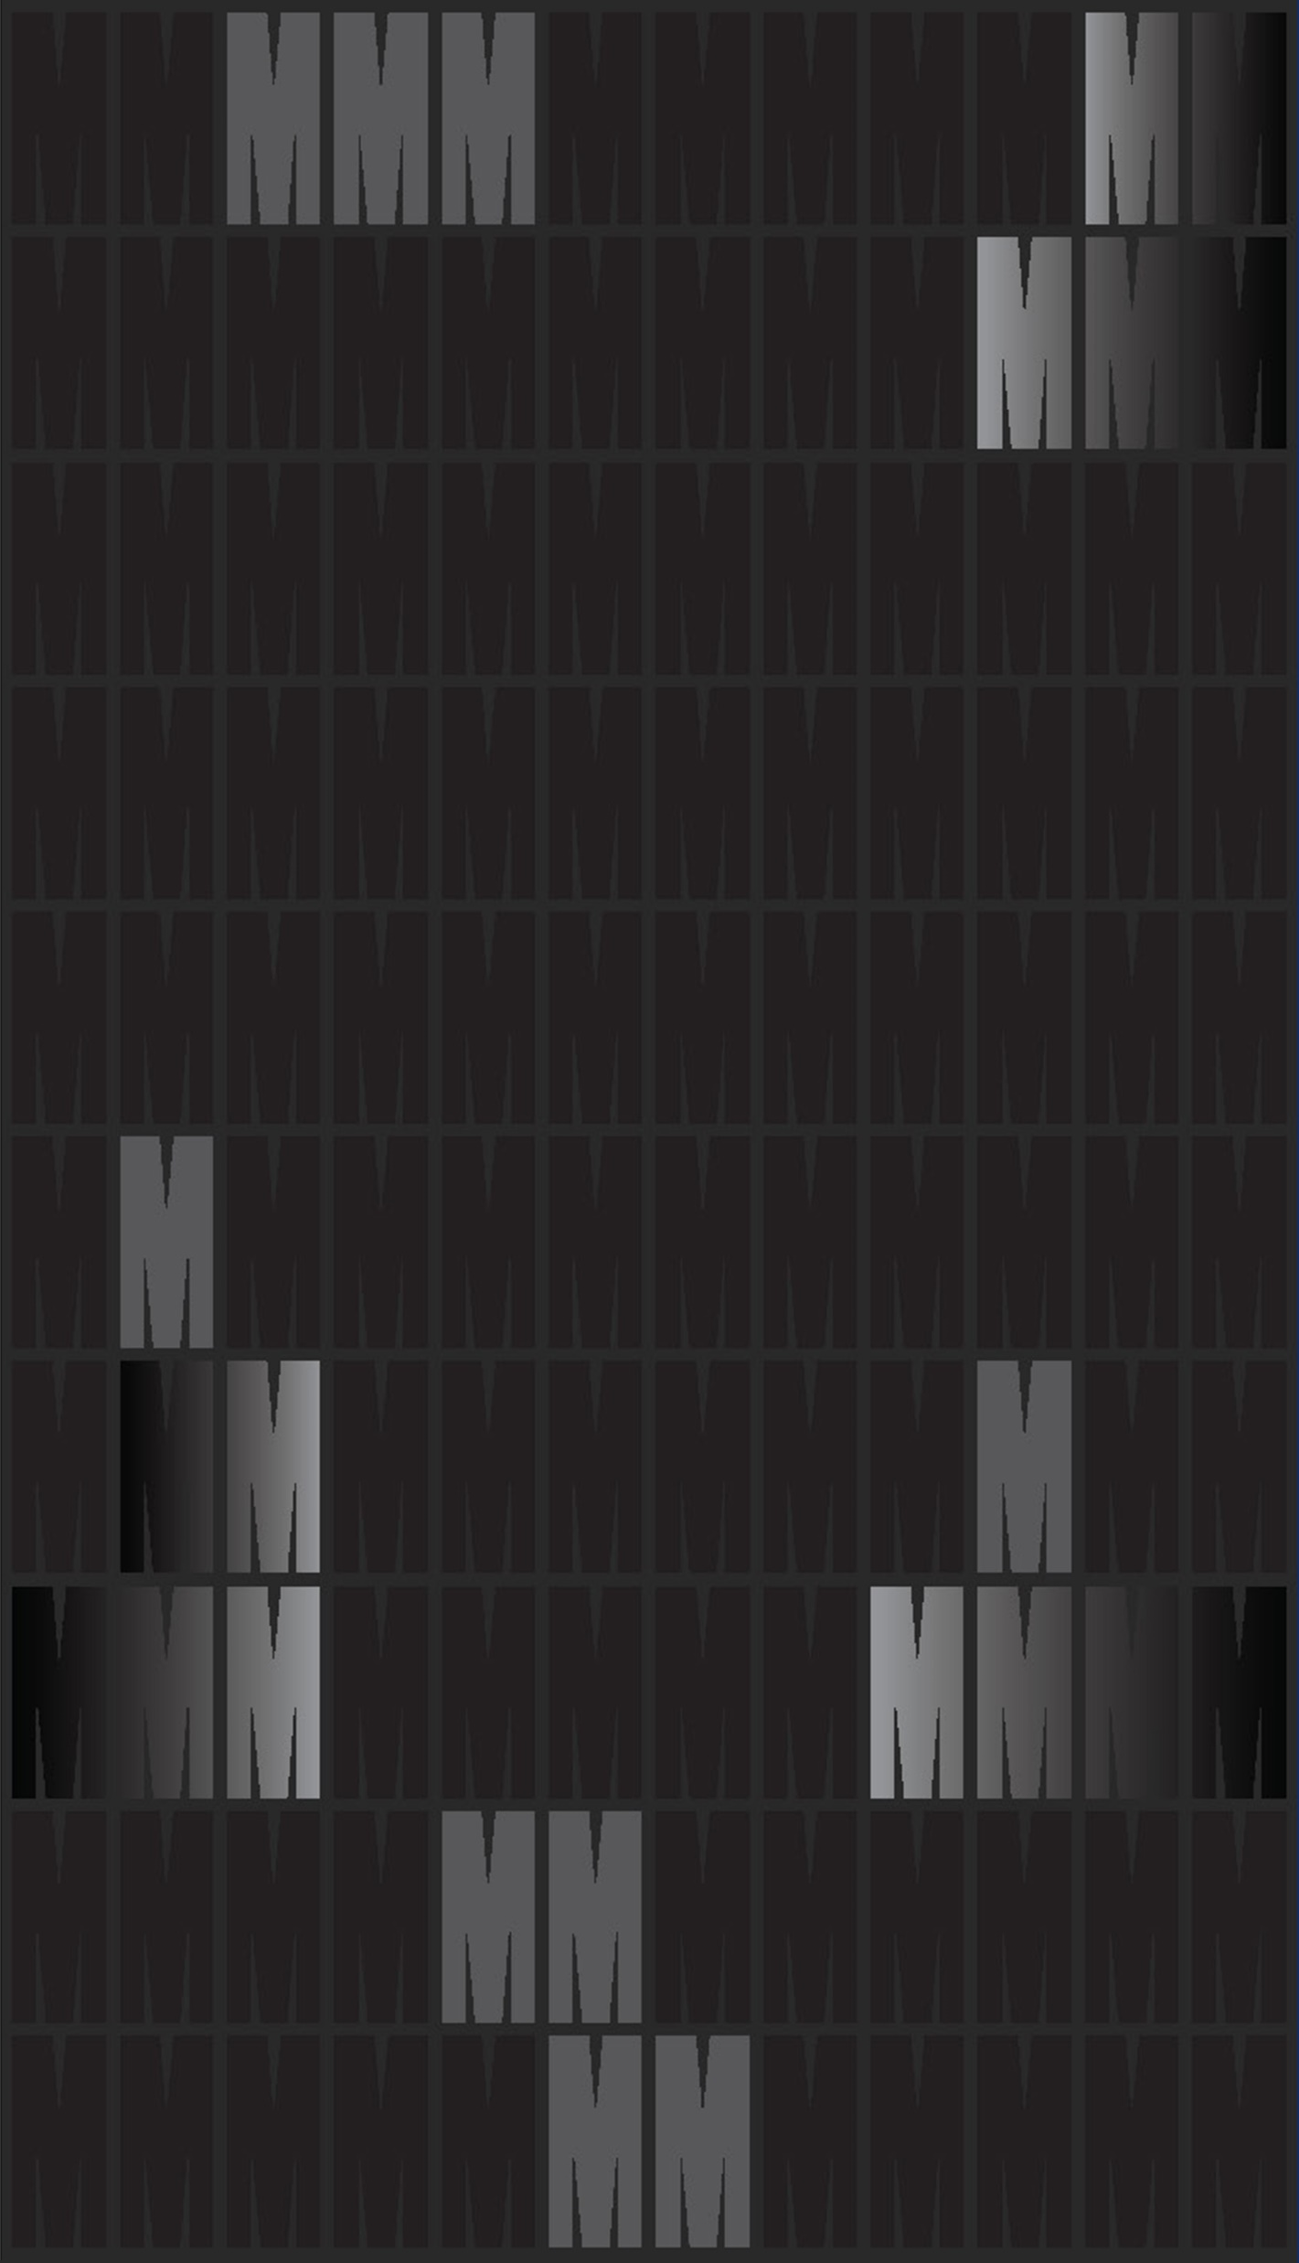
Studio activities Agenda
Introduction to Spatial Data Formats
Visualisation 2 Assignment Discussion
Practice : Obtaining Spatial Data
Practice : Proportional Symbol Maps
Practice : Choropleth Maps
Reminders

Slide 3
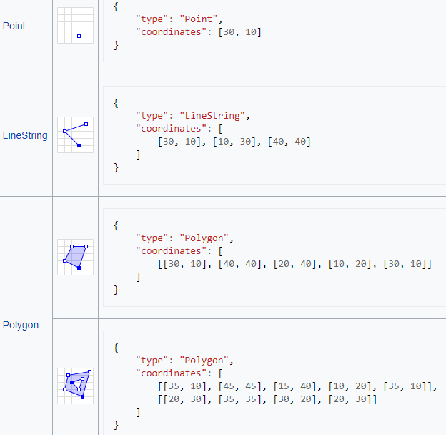
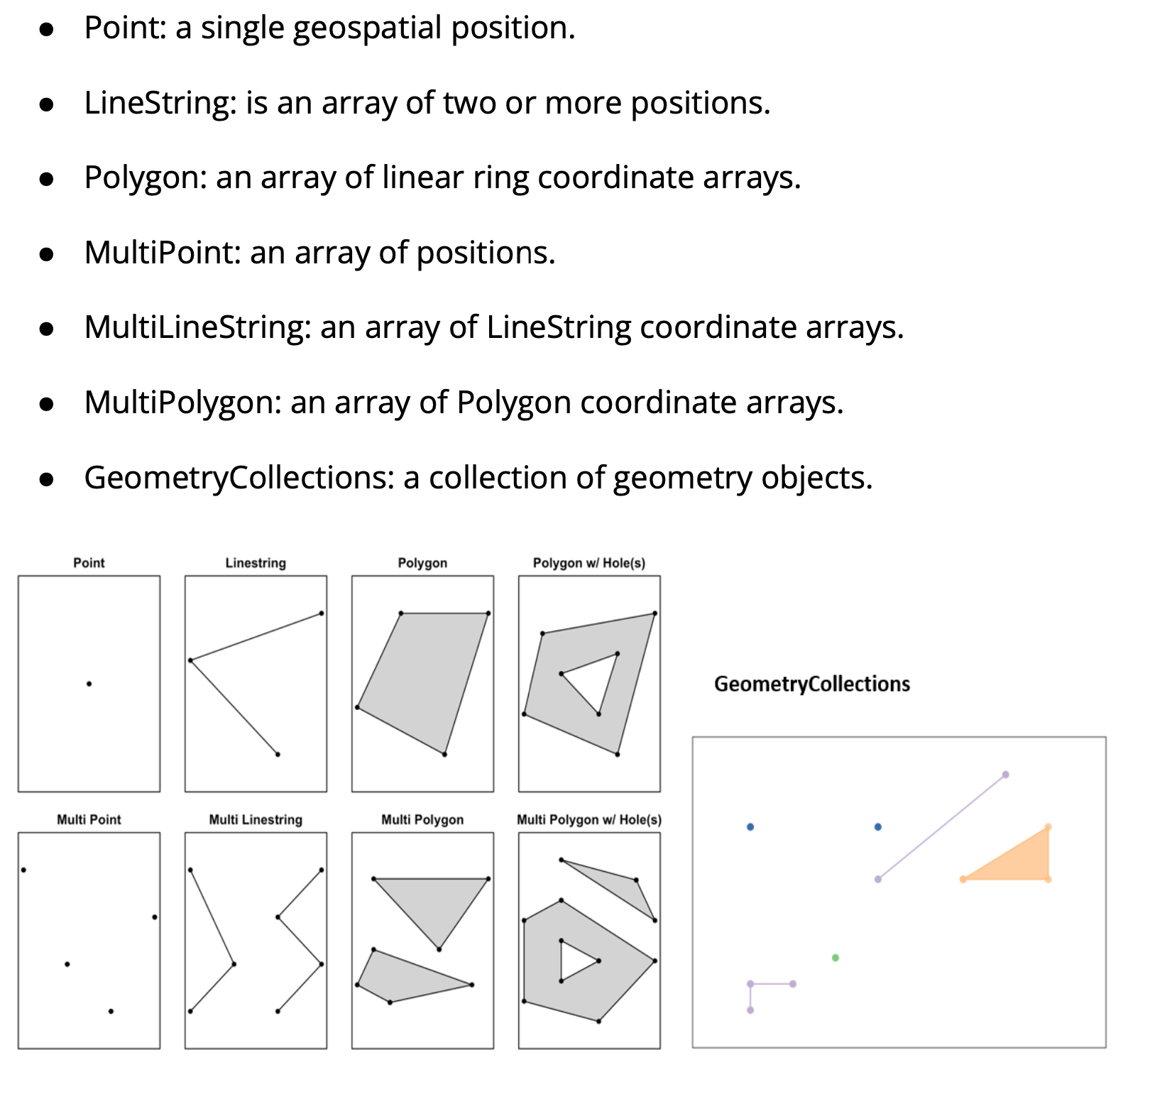
Introduction to Spatial Data Formats
Notes:
Topology, in simple terms, is the study of shapes and spaces, focusing on properties that remain unchanged even when the shapes are stretched, twisted, or deformed in various ways. Imagine a rubber sheet: you can stretch and twist it, but you can't tear or glue it. So, in topology, a rubber circle, square, and triangle are all considered the same because you can morph one into the other without cutting or gluing.
Another common example: A donut and a coffee mug are considered "topologically equivalent" because you can transform one into the other without tearing or attaching any part. Both have one hole—the donut in its center and the mug through its handle.
In essence, topology looks at properties of spaces that remain constant through certain deformations, without being concerned about distances, angles, or other precise measurements.

Slide 4
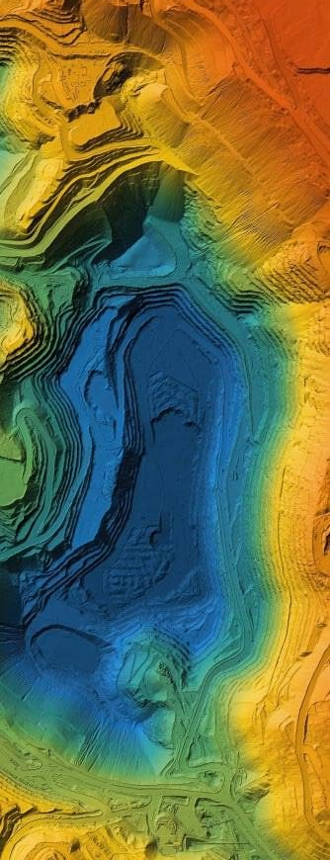

Introduction to Spatial Data Formats
Notes:
Topology, in simple terms, is the study of shapes and spaces, focusing on properties that remain unchanged even when the shapes are stretched, twisted, or deformed in various ways. Imagine a rubber sheet: you can stretch and twist it, but you can't tear or glue it. So, in topology, a rubber circle, square, and triangle are all considered the same because you can morph one into the other without cutting or gluing.
Another common example: A donut and a coffee mug are considered "topologically equivalent" because you can transform one into the other without tearing or attaching any part. Both have one hole—the donut in its center and the mug through its handle.
In essence, topology looks at properties of spaces that remain constant through certain deformations, without being concerned about distances, angles, or other precise measurements.

Slide 5
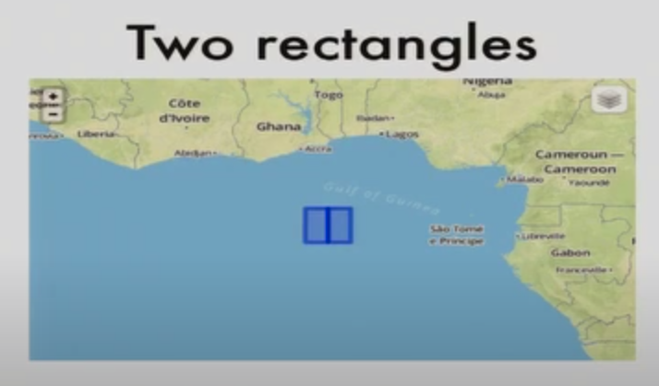
Introduction to Spatial Data Formats
Notes:
Topology, in simple terms, is the study of shapes and spaces, focusing on properties that remain unchanged even when the shapes are stretched, twisted, or deformed in various ways. Imagine a rubber sheet: you can stretch and twist it, but you can't tear or glue it. So, in topology, a rubber circle, square, and triangle are all considered the same because you can morph one into the other without cutting or gluing.
Another common example: A donut and a coffee mug are considered "topologically equivalent" because you can transform one into the other without tearing or attaching any part. Both have one hole—the donut in its center and the mug through its handle.
In essence, topology looks at properties of spaces that remain constant through certain deformations, without being concerned about distances, angles, or other precise measurements.

Slide 6
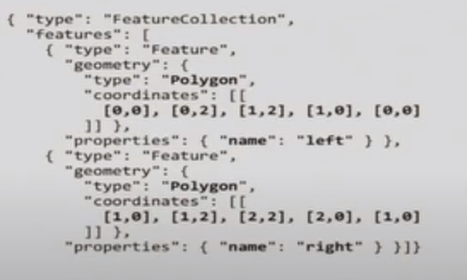
Introduction to Spatial Data Formats
GeoJSON
Notes:
Topology, in simple terms, is the study of shapes and spaces, focusing on properties that remain unchanged even when the shapes are stretched, twisted, or deformed in various ways. Imagine a rubber sheet: you can stretch and twist it, but you can't tear or glue it. So, in topology, a rubber circle, square, and triangle are all considered the same because you can morph one into the other without cutting or gluing.
Another common example: A donut and a coffee mug are considered "topologically equivalent" because you can transform one into the other without tearing or attaching any part. Both have one hole—the donut in its center and the mug through its handle.
In essence, topology looks at properties of spaces that remain constant through certain deformations, without being concerned about distances, angles, or other precise measurements.

Slide 7
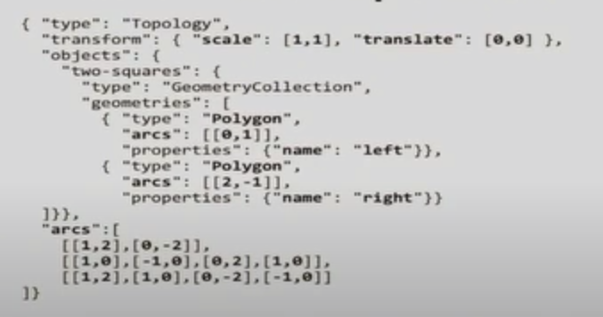
Introduction to Spatial Data Formats
GeoJSON
TopoJSON
Notes:
Topology, in simple terms, is the study of shapes and spaces, focusing on properties that remain unchanged even when the shapes are stretched, twisted, or deformed in various ways. Imagine a rubber sheet: you can stretch and twist it, but you can't tear or glue it. So, in topology, a rubber circle, square, and triangle are all considered the same because you can morph one into the other without cutting or gluing.
Another common example: A donut and a coffee mug are considered "topologically equivalent" because you can transform one into the other without tearing or attaching any part. Both have one hole—the donut in its center and the mug through its handle.
In essence, topology looks at properties of spaces that remain constant through certain deformations, without being concerned about distances, angles, or other precise measurements.

Slide 8
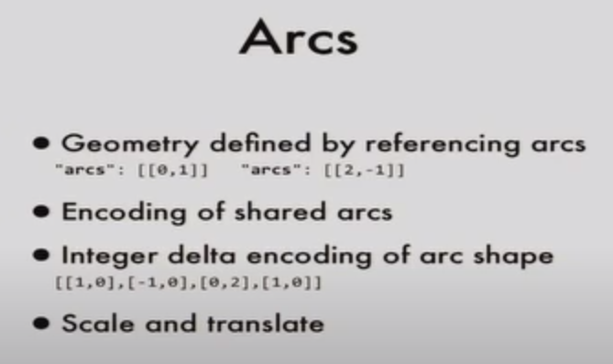
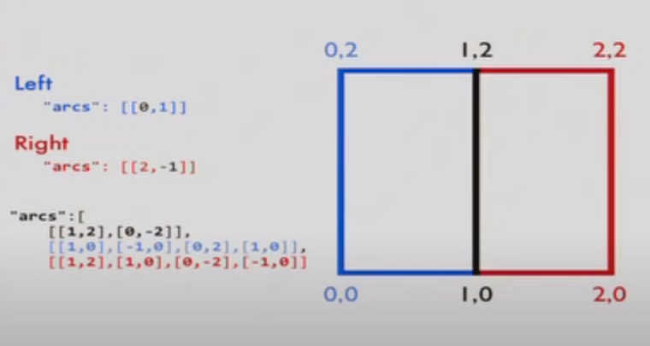
Introduction to Spatial Data Formats
Notes:
Topology, in simple terms, is the study of shapes and spaces, focusing on properties that remain unchanged even when the shapes are stretched, twisted, or deformed in various ways. Imagine a rubber sheet: you can stretch and twist it, but you can't tear or glue it. So, in topology, a rubber circle, square, and triangle are all considered the same because you can morph one into the other without cutting or gluing.
Another common example: A donut and a coffee mug are considered "topologically equivalent" because you can transform one into the other without tearing or attaching any part. Both have one hole—the donut in its center and the mug through its handle.
In essence, topology looks at properties of spaces that remain constant through certain deformations, without being concerned about distances, angles, or other precise measurements.

Slide 9
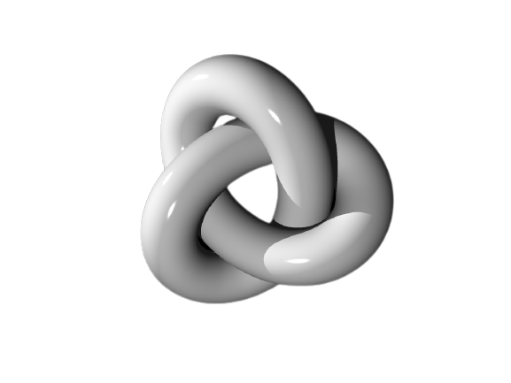
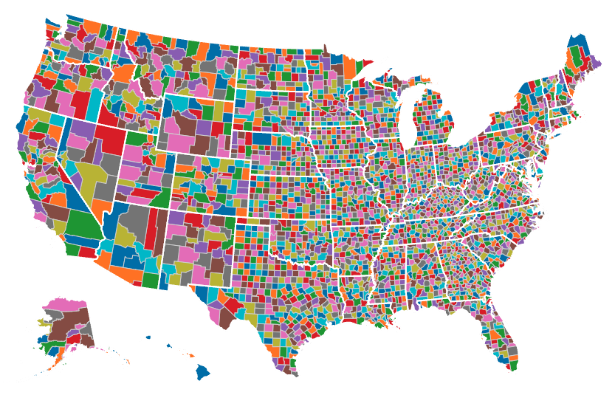
TopoJSON
https://observablehq.com/@neocartocnrs/cheat-sheet-topojson
https://observablehq.com/@spattana/topojson-and-geovisualization
Notes:
Space Efficiency:
TopoJSON is a space-efficient text format for geographic data that encodes topology.
It provides significant size savings compared to GeoJSON.
TopoJSON is about 2/3 the size of GeoJSON with properties removed.
Topology Encoding:
TopoJSON can compress data at a deeper semantic level and allows for efficient visualization of topology.
It adds a new type called topology that identifies shared arcs, shared boundaries, and adjacent polygons.
It preserves topology, which is especially crucial when simplifying map representations.
Flexibility and Versatility:
TopoJSON uses arcs instead of points to define objects, leading to more efficient file sizes.
Each arc is encoded with an integer delta encoding of the arc shape.
The format is used to draw shapes and boundaries in a geographic area.
It is adaptable for browser delivery and presentations.
Preservation of Adjacencies:
TopoJSON is effective at preserving the adjacency of countries in visualizations.
This is crucial for accurate representation and visualization of borders and shared boundaries.
Effective Conversion and Simplification:
Tools and methods exist to convert and simplify shapefiles to TopoJSON format efficiently.
The format supports various levels of quantization and simplification depending on the desired map resolution.
Rich Tool Ecosystem:
There are various tools available for using TopoJSON, such as command-line tools, browser APIs, and a wiki.
Projects like 'us Atlas' by Bostock generate TopoJSON files for specific purposes, like US counties.
Complementary to Other Formats:
While TopoJSON provides many advantages, it can also work alongside other formats. For instance, TopoJSON and Protocol Buffer can be used together for different purposes, combining the strengths of both.

Slide 10
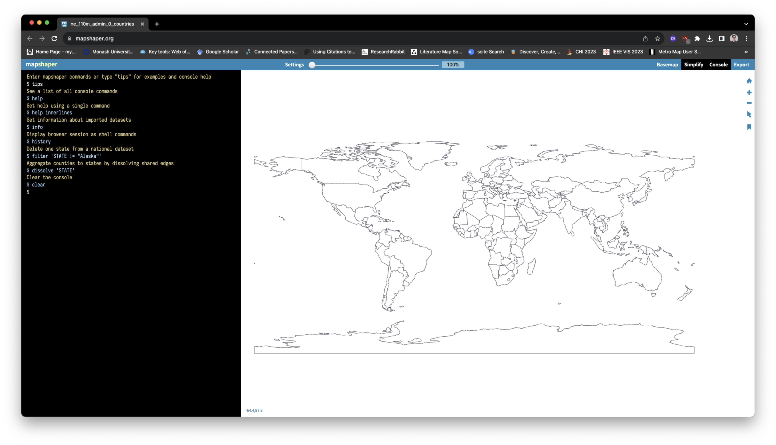
Visualisation 2 Assignment Discussion (45～ minutes) Others: self-learn Section 2 “Obtaining Spatial Data
Try to get the shapefile of the word,
And TopoJSON for your home country

Slide 11
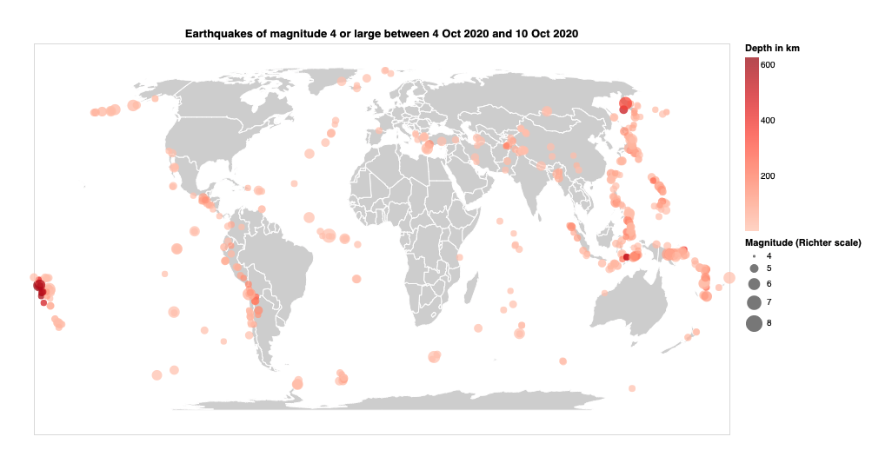
Proportional Symbol Maps
Try to modify the encodings and check the corresponding results. For example, use the colour channel to encode the magnitude (“mag” attribute) of the earthquake and use the size channel to encode the duration (“dmin” attribute) of the earthquake.
Also try to add a new encoding: “shape”, and use it for the location source (locationSource attribute). See if there is any warning for this encoding.
Do you understand why? Can you fix it?

Slide 12
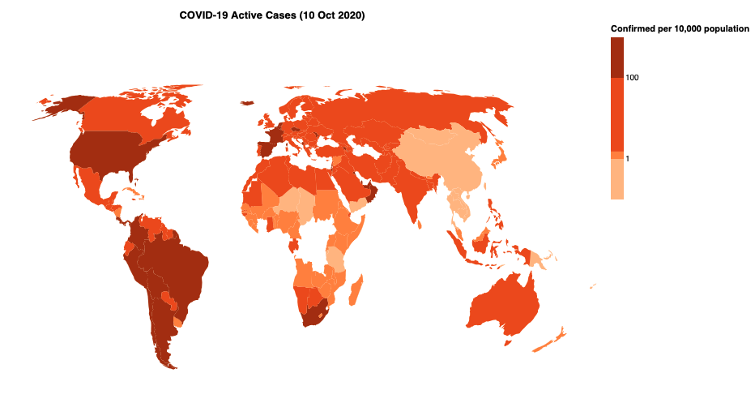
Choropleth Maps
Did you notice that there are some countries (e.g., Congo) shown as blank on the map? Discuss with the tutor and your peers:
● What could be the cause of this?
● What is the best way to handle this?
● Can you include more information in tooltip and stylish it.

Slide 13
THANK YOU
Reminders:
Homework Week 9: Vega-Lite Maps
Contact Information:
If you need to reach me, please use one of the following communication channels:
Email: songhai.fan@monash.edu or frank.fan@monash.edu
Office Hours: Wednesday 2-4pm, 21 College Walk, Clayton VIC 3168

